Slide 1



Global Education Policy Dashboard Rollout
New Data for Building Back Better
Wednesday, May 12, 2021
10:00 AM - 11:30 AM (EDT)
Notes:
Thank you all for joining us today.

Slide 2
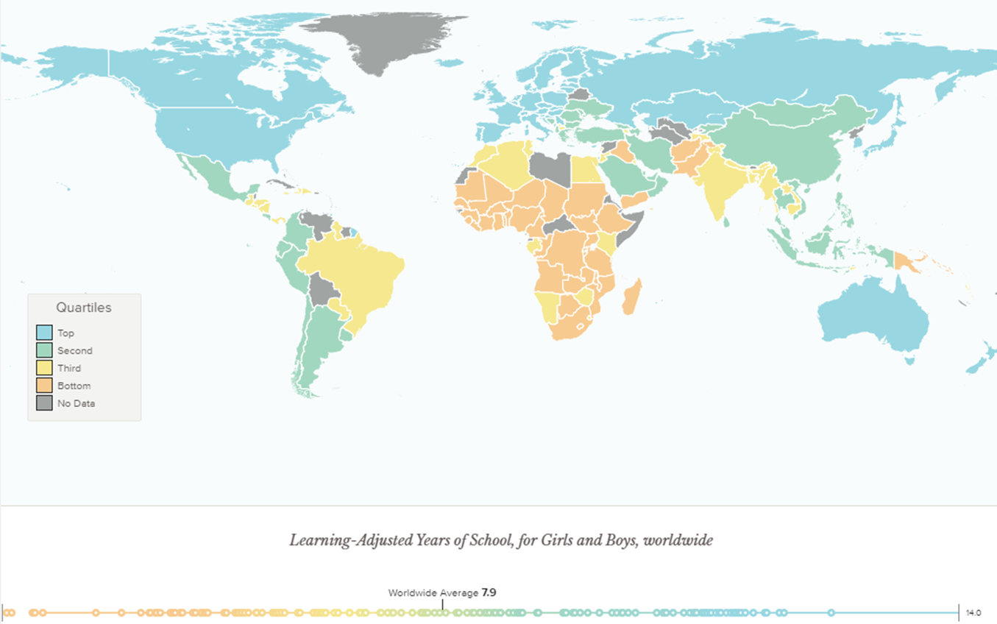
Learning disparities exacerbate schooling gaps
Notes:
This map starkly shows the learning crisis. Learning disparities worsen schooling gaps, leading to very low learning-adjusted years of schooling in many countries.

Slide 3
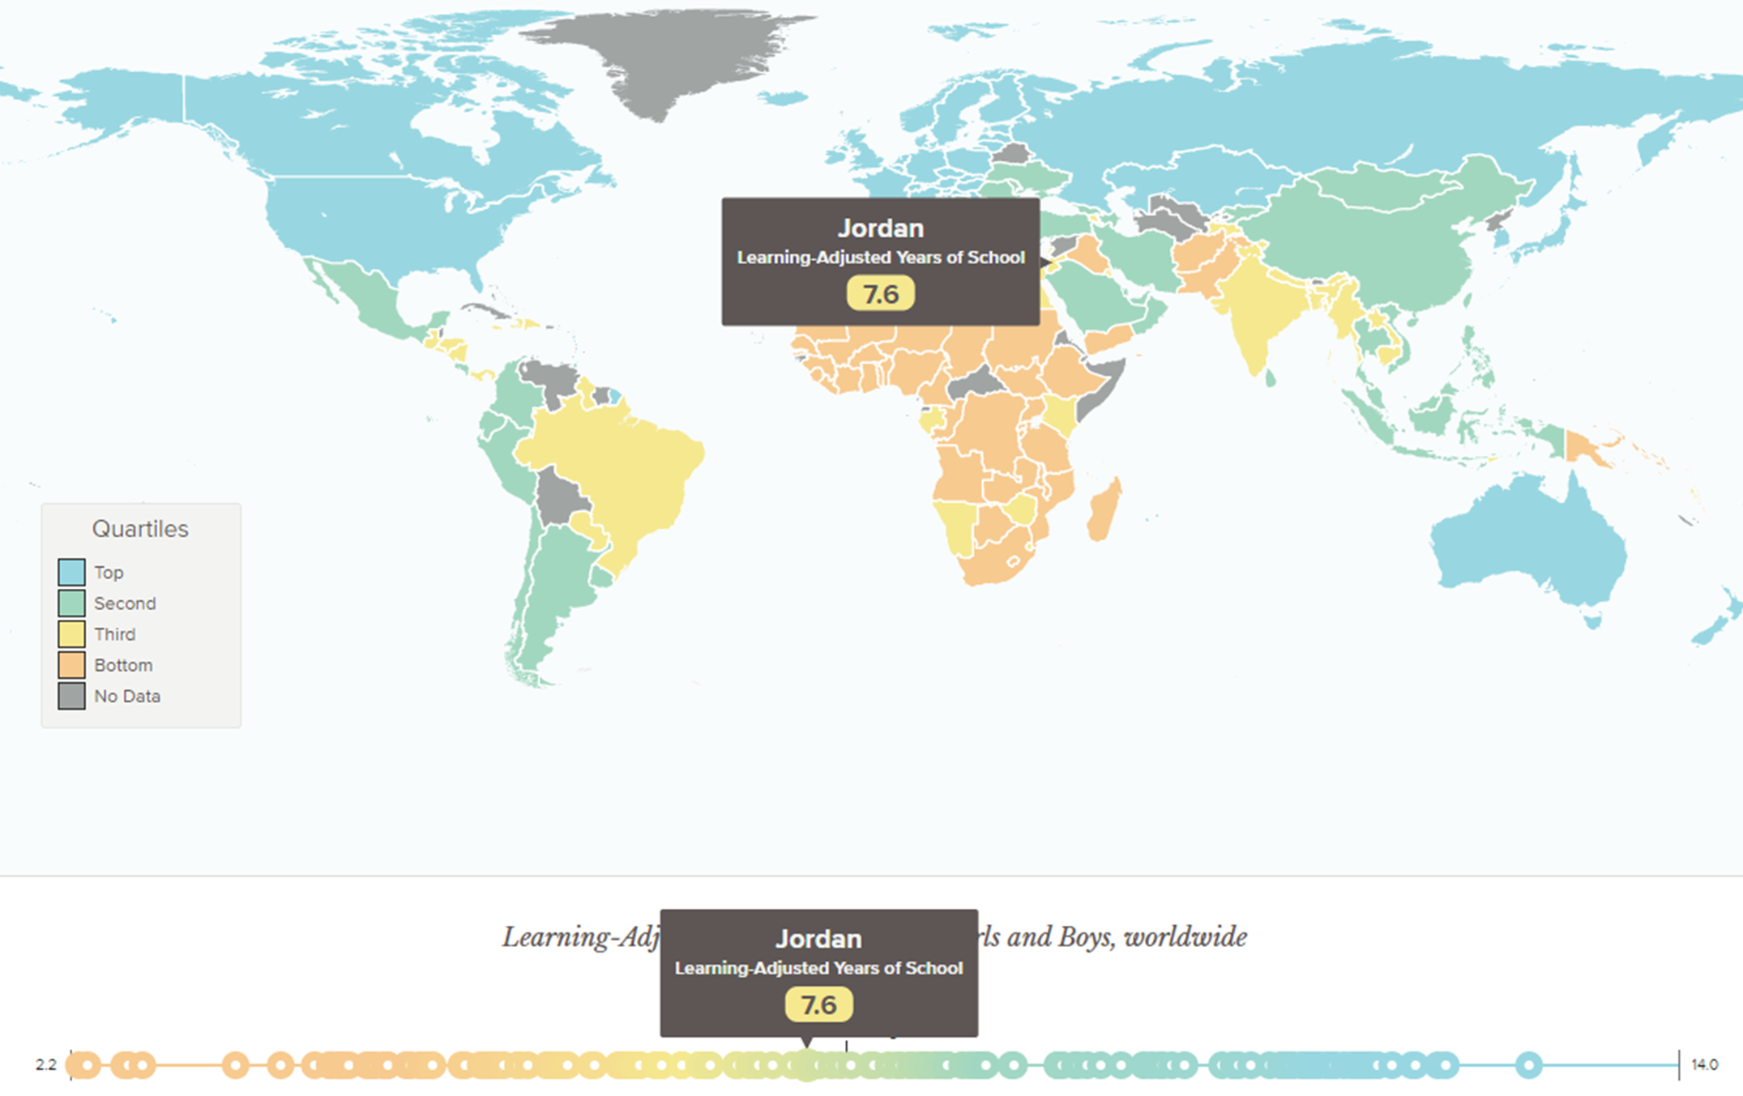
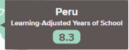
Learning disparities exacerbate schooling gaps
Learning disparities exacerbate schooling gaps
So what to do?
Notes:
For the first two Dashboard countries--Jordan and Peru, which we’ll be presenting data on today--the average child can expect to complete just around 8 learning-adjusted years of schooling, or LAYS, by age 18.
But for many countries, including others where the Dashboard is being implemented like Rwanda and Ethiopia, the totals are much lower still—at around 4 LAYS per child.
Metrics like this one and the Learning Poverty indicator have driven home for many policymakers and other stakeholders the size of the challenge they face.
But for the individual countries, these indicators don’t tell us what is driving such low learning, or where the barriers are, or whether countries are moving in the right direction to improve quality and access in ways that will eventually show up in higher LAYS scores and lower Learning Poverty rates.
And that’s why, working with many partners inside and outside the institution, we developed the Global Education Policy Dashboard.

Slide 4





Learning disparities exacerbate schooling gaps
So what to do?
Especially in the context of COVID-19, in which…
Extended school closures deepen the learning crisis
Economic shocks precipitate budgetary constraints
Countries will need to spend smarter to build back better education systems and accelerate learning for all
Here is where the Global Education Policy Dashboard can help.
Notes:
Since we began work two years ago, COVID-19 has made the needs even greater.
It’s not just the extended school closures, which are leading to unprecedented learning losses. On top of that, two-thirds of low- and lower-middle-income countries have, in fact, cut their public education budgets since COVID-19 hit. Protecting those budgets is crucial. But this also highlights the need to spend smarter—ensuring that all financing is effectively deployed to improve and sustain learning for all children.
With so many needs, it’s hard to know where to start. There is strong demand for tools that can help in setting priorities for action.

Slide 5
Goal: Measure and highlight the key drivers of learning outcomes
Notes:
The goal of the dashboard is to respond to this need: to shine a light on the key drivers of learning, throughout the system, to allow prioritization and monitoring of progress in the short and medium term.

Slide 6
Our Framework
Notes:
As a conceptual framework for the dashboard, we use the framework from

Slide 7


Our Framework
World Development Report 2018 (WDR)
Future of Learning
2020
Notes:
The World Development Report 2018, “Learning to Realize Education’s Promise,”
as developed further in the recent “Realizing the future of learning” report.

Slide 8

Notes:
It is essential to put learning for all children at the center. So the first question to ask is: Are children in school and learning?
But at the system level, learning itself is not actionable: That’s why the Dashboard has to take into account, first, all the school- and student-level ingredients that make learning possible. We think of these as the “service delivery” or “practice” indicators.
WAIT BEFORE CLICK
When we talk about learning, we have to first talk about CLICK

Slide 9
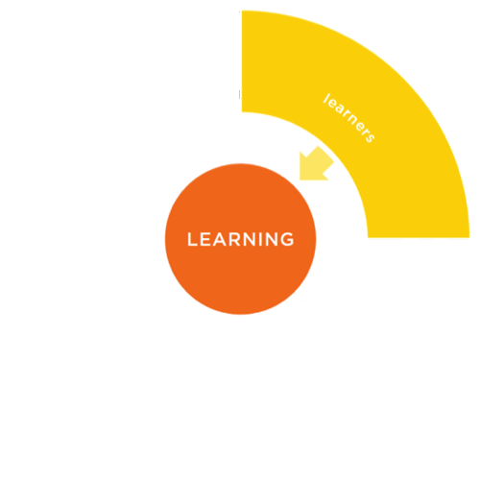
Notes:
learners
Are students arriving in the schools prepared and ready to learn? That is, are they healthy and well-nourished children who have benefited from stimulation in early childhood?
Next we have to talk about
CLICK

Slide 10
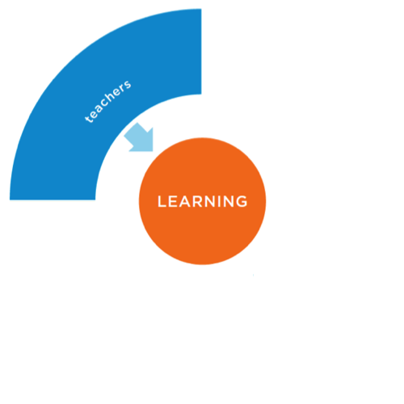
Notes:
The teachers: learning depends on having prepared, motivated, well-supported teachers in the classrooms engaging the students.
We also have to talk about
CLICK

Slide 11
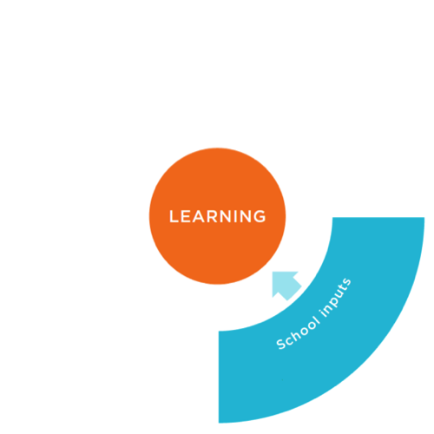
Notes:
school inputs and infrastructure—whether schools have them, and whether they improve the teaching and learning process.

Slide 12
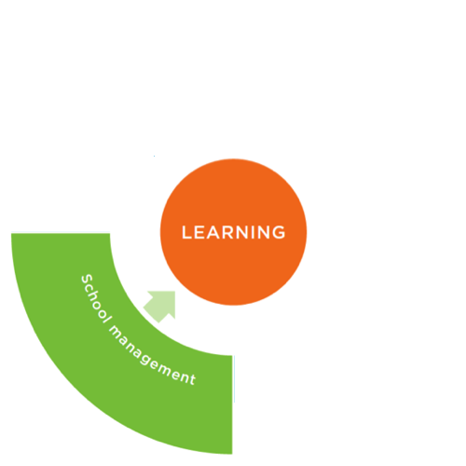
Practices
Notes:
And finally, we need capable school management to bring all these elements together—effective principals, and also management structures that support teaching and learning in schools.
But we also need to go beyond the school-level factors to think about the broader system that influences what educators and students do. Teachers, principals and students are not acting in a vacuum. They are responding to the signals and incentives set by the system as a whole.
This broader framework includes first, CLICK

Slide 13
Policies
Practices
Notes:
policies: Does the policy framework support good learning outcomes?
Here, it’s crucial to evaluate both the policy design (or de jure policies) and the de facto implementation of policies in schools.

Slide 14
Politics
Policies
Practices
Notes:
And finally, a system-wide view must include what we call the politics, shorthand for the political and bureaucratic environment in which those policies are created and implemented: Are there political incentives and bureaucratic capacity to deliver learning for all children?
So to understand whether a system is delivering for learning, we need to understand all three levels, the three Ps—practice, policies, and politics.
The Global Education Policy Dashboard applies this holistic framework to collect a concise set of indicators that allow tracking and improvement of these determinants of learning.

Slide 15
Financing
Characteristics of Bureaucracy
Impartial Decision-Making
Mandates & Accountability
National Learning Goals
Inputs & Infrastructure
Learners
Nutrition Programs
Standards
Basic Inputs
Readiness for Learning
Health Programs
Student Attendance
Early Childhood Education
Monitoring
Basic Infrastructure
Learning
Caregiver Skills Capacity
Caregiver Financial Capacity
School Management
Teaching
Core School Functions
Teachers’ Skills
Attraction
Clarity of Functions
Operational Management
Content Knowledge
Selection & Deployment
Instructional Leadership
Pedagogical Skills
Support
Attraction
Selection & Deployment
Managerial Skills
Evaluation
School Knowledge
Monitoring & Accountability
Support
Management Practices
Teacher Presence
Evaluation
Intrinsic Motivation
Notes:
The Dashboard includes information on these 39 key indicators covering these different levels. First, focusing on outcome indicators capturing learning for all, flanked by indicators representing the four-main school-level service-delivery factors. And later offering the next set of indicators in dark blue on the policies that affect each of these areas, and finally, at the top, the set that captures the political context and bureaucratic capacity of the system.

Slide 16
Our Methodology
Notes:
What’s the methodology for implementing this framework?

Slide 17
Filling in the Global Education Policy Dashboard by
Identifying gaps in administrative systems, either because data are:
Not Collected
(E.g., school readiness)
Unreliable
(E.g., teacher presence)
Working with governments to collect new data, through:
School Survey
Policy Survey
Survey of Public Officials
Notes:
Ideally, we would just fill in the dashboard with administrative data that governments already collect in their EMIS.
But in practice, these Administrative systems lack much of the data required, either because the data are:
Not collected (as in the case of indicators of the quality of teaching, management quality, or children’s readiness for learning when they arrive at school)
Unreliable (as, for example, with teacher attendance)
So we work with governments to collect new data in each country where we implement the Dashboard, through three surveys implemented simutaneously:
School survey (of a representative sample of 200-300 schools)
Policy survey (working through a local expert to assess policy quality)
Survey of public officials (sample of 200 national and district-level officials in randomly selected districts)

Slide 18
A variety of sound tools are available to measure each of these indicators—
the Dashboard project brings them together to create a streamlined unified instrument.
Service Delivery Surveys (SDI)
1. School Survey
Practices
Classroom Observation Tool
Development World Management Survey
Child Development Measurement Tools
Notes:
These Dashboard surveys benefit greatly from innovative measurement tools developed by colleagues and partners over the past decade to map out different levels or dimensions of an education system. A challenge for policymakers has been that the application of these tools hasn’t been coordinated: many countries have applied only one or a few, and none has been able to implement all of them. As a result, they are able to see only part of the system—or, to use the old metaphor, just part of the elephant.
The Dashboard streamlines and combines these tools, so that all information can be collected at once, quickly and cost-effectively.
For the school survey, we have combined instruments like the pathbreaking SDI instruments; the classroom observation tool Teach; MELQO, which measures cognitive and socioemotional preparation of early learners, and the Development World Management Survey, which has applied systematic monitoring of management quality to education.

Slide 19
Policies
Policies
Service Delivery Surveys (SDI)
1. School Survey
Practices
Practices
Classroom Observation Tool
2. Policy Survey
Development World Management Survey
Child Development Measurement Tools
SABER Policy Measurement Tools
Notes:
A Policy survey (working through a local expert)
For the policy survey, we have streamlined the SABER Policy Measurement tools, focusing on the policies that most directly govern service delivery in these key areas.

Slide 20
Politics
Policies
Service Delivery Surveys (SDI)
1. School Survey
Practices
Classroom Observation Tool
2. Policy Survey
Development World Management Survey
Child Development Measurement Tools
3. Survey of Public Officials
SABER Policy Measurement Tools
Bureaucracy Lab Survey
Notes:
And lastly, for the Survey of public officials, we have worked with our colleagues in DEC and the Governance GP to adapt their innovative Bureaucracy Lab surveys to make them more applicable for the education sector.
As I will detail in a minute, the advantage of streamlining in this way and of using a common fieldwork operation is that it provides a comprehensive overview of the system at much lower cost

Slide 21
While also leveraging innovations
Inclusive education measures
EdTech measures
Growth mindset and teacher values
Socioemotional skills of students and teachers
School management
And much more!
School accessibility to children with physical disabilities
Toilet accessibility to children with physical disabilities
Classroom accessibility to children with physical disabilities
TLMs for children who are blind or deaf
Teacher training on inclusive education pedagogy
Available screenings to assess vision, hearing, motor skills and learning).
Notes:
But first, I want to mention examples of some of the other innovations that are reflected in the Dashboard, drawing on great ideas from around the sector, including work done by many of you.
It includes measures of inclusive education gathered at school level by enumerators who observe and record, for example, whether classrooms and toilets are accessible to children with physical disabilities, and who ask teachers are asked whether they have been trained on inclusive education pedagogy (which tells us whether system-level reforms translate into actual support for teachers).

Slide 22

While also leveraging innovations
Inclusive education measures
EdTech measures
Growth mindset and teacher values
Socioemotional skills of students and teachers
School management
And much more!
Capturing the extent to which EdTech is available within the schools and integrated within classroom practices
To strengthen these measures, support the development and piloting of the EdTech Readiness Index
Notes:
We include EdTech measures, which are especially relevant now. Enumerators report whether technology is available at the school and test the connectivity, to provide a check on how measures of system-wide policy are making it to the school. And the Teach observation tool picks up whether teachers are integrating technology into their classroom practice.

Slide 23
While also leveraging innovations
Inclusive education measures
EdTech measures
Growth mindset and teacher values
Socioemotional skills of students and teachers
School management
And much more!
Measures of growth mindset for teachers and public officials, adapted from Carol Dweck. For instance, whether they agree/disagree with Students can always substantially change how intelligent they are
Measures on teachers’ values and opinions regarding their students. For instance, whether they agree/disagree with Students deserve more attention if they attend school regularly.
Notes:
Third, we include measures of mindset and values. For example, there are questions to teachers about growth mindset, whether they agree or disagree with statements like “Students can always substantially change how intelligent they are.” And questions about teachers values and opinions, such as agreement with statements like “Students deserve more attention if they attend school regularly.”

Slide 24

While also leveraging innovations
Inclusive education measures
EdTech measures
Growth mindset and teacher values
Socioemotional skills of students and teachers
School management
And much more!
Capturing students’ socioemotional skills when they first arrive to primary school through a 1st grade direct assessment, adapted from MELQO
Capturing teachers’ fostering of socioemotional skills in the classroom through a direct classroom observation, based on the classroom observation tool, Teach
Measuring Early Learning Quality and Outcomes (MELQO)
Notes:
Fourth, we have measures of the socioemotional skills of students when they first arrive at primary school, as measured through the MELQO-based assessment of 1st-graders, and also observation-based measures of how well teachers foster socioemotional skills in the classroom.

Slide 25
While also leveraging innovations
Inclusive education measures
EdTech measures
Growth mindset and teacher values
Socioemotional skills of students and teachers
School management
And much more!
Measures of principal school knowledge, management skills, and effective operational management that can be linked to other school-level factors, highlighting important relationships.
Notes:
As a final example, there are multiple measures of management—measures of the principal’s management skills and knowledge of the school, and of the effectiveness of operational management.

Slide 26

The benefits of streamlining and combining the surveys
Faster access to data
Lower data collection costs
More comprehensive
3 months
From start to finish
¼ of the cost
While more streamlined, the GEPD can offer a first cut diagnostic for a fraction of the price
78% explained*
Share of between-school learning variation explained by the Dashboard’s Practice & De-Facto Policy indicators
*Based on Peru data
The GEPD offers an overall view of the system, allowing countries to determine what areas require action or more in-depth investigation
Notes:
Finally, let me just come back to the benefits of streamlining and combining these other instruments in the Dashboard.
A key advantage is ease and speed of implementation. Once all the government approvals are ready, the implementation can be done in three months—including training, field work, and calculation of indicators. This is possible because the streamlining reduces the time needed in each school, so that fieldwork can be compressed; and also because all the instruments and analysis are pre-programmed into open-source survey software.
Another benefit is that cost is reduced by about 3/4, compared with the cost of implementing all these other tools, which makes the Dashboard quite affordable as a first-cut overall system diagnostic – one that can both provide actionable insights and identify where more in-depth measurement (for example, with one of the existing tools) may be necessary.
And so far, we are finding that the data gathered in this way has a lot of explanatory power. In the case of Peru, we are able to explain 78% of the between-school variation using the Practice and de facto Policy indicators.
Now that you understand where the data comes from and why, Sergio will tell you something about what we’re learning.

Slide 27
A Brief Introduction to the GEPD Data
Notes:
Thank you, Halsey. This next part of the presentation provides a flavor of what the dashboard looks like, which hopefully will spark your interest.

Slide 28














Where we are
Rwanda
Jordan
Peru
Completed Implementation
Ethiopia
Mozambique
Madagascar
Partial & Ongoing Implementation
Planned Implementation
Notes:
By way of starting, I should note that the dashboard has been fully implemented in three countries – Peru, Jordan, and Rwanda. In another three countries, we are in the process of completing data collection. And we have several countries in the pipeline. Many of which are part of the new Accelerator Program.

Slide 29
Comprehensive and streamlined instruments
Politics
To produce indicators of the drivers of learning system-wide, we deployed three instruments:
1. School Survey
200-300 schools
Nationally representative sample
2. Survey of Public Officials
200 public officials
Adjusted by country, default: 60 national, 70 regional, and 70 district level officials
3. Policy Survey
Legislative review
Policies
Practices
Notes:
In each country, three surveys are applied. First, a school survey applied to a sample of between 200 and 300 schools; the goal is to have a nationally representative sample that can also offer key breakdowns. Then there is the survey of public officials applied to a sample of 200 public officials at all levels of the bureaucracy. And finally, the Policy Survey, which involves a legislative review of existing laws and policies.

Slide 30
3 Colors to Understand the System
Percentages – 0%-85%
Points – 1-3
Percentages – 85%-90%
Points – 3-4
Percentages – 90%-100%
Points – 4-5
Needs Improvement
Caution
On Target
- Current Thresholds - Based on information in Peru, Jordan and Rwanda
- Possible Revisions - The Dashboard is being implemented in 11 more countries, and this may lead to revisions of the thresholds used in the future
Notes:
In order to make the presentation of the data as clear, intuitive, and user-friendly as possible. We use a traffic light color-coding approach to signal to stakeholders what indicators need improvement, caution, or are currently on target. These thresholds have been determined using the data that we have collected thus far, so as we continue to add more countries to the dashboard, they may be adjusted to ensure they work for different types of country contexts.

Slide 31
Peru case - Shining light on learning and its drivers
Teaching
Learners
Content Knowledge
39% of teachers are proficient in the content they teach
Teacher skills (measured by direct observation and content assessment) and early capacity for learning (measured by direct assessment) stand out as the biggest problems
Readiness for Learning
53% of children have basic skills to succeed in primary
Pedagogical Practices
34% of teachers have satisfactory pedagogical skills
Student Attendance
93% of students are present during unannounced visit
Learning Poverty
56%
Teacher Presence
91% of teachers are present during unannounced visit
School Management
Inputs & Infrastructure
Operational Management
4.3 (out of 5) - Score on presence & quality of core operational functions
Basic Inputs
4.1 – Average basic inputs (out of 5) found in the typical school
Instructional Leadership
3.3 (out of 5) - Score on the presence & quality of instructional leadership
Electricity (98%)
Drinking water (91%)
Functioning Toilet (68%)
Accessibility (65%)
Internet (54%)
Basic Infrastructure
3.7 – Average basic infrastructure (out of 5) found in the typical school
School Knowledge
3.6 (out of 5) – Score on principals’ familiarity with the school
Management Skills
4.3 (out of 5) – Score on the quality of principals’ managerial skills
Notes:
To give a flavor of what the data looks like, we can look at the data collected in Peru. As Halsey mentioned earlier, the dashboard focuses first on what matters most, that is the outcomes as well as the practice indicators that are responsible for the type of education children get.
We can see that the Learning Poverty rate is quite high, indicating that there is room for improvement. When looking at the practices that could be driving such low learning, two stand out – Teaching skills, including both, content knowledge of teachers as well as their pedagogical practices. And then there is also the readiness for learning that children have when they first arrive to school, that is their cognitive and socioemotional skills.
Other indicators are identified as caution, their overall level is positive, but certain elements within them could be improved. Fr instance, when looking at Basic Infrastructure, we see that most schools are equipped with drinking water and electricity, but many are not accessible to children with physical disabilities or lack internet access.
At last, we can see that there are indicators that show good levels, and that includes aspects such as teacher presence or the principal management skills, both of which are aspects that have been prioritized by the ministry of education in recent years.
So through this quick snapshot, stakeholders can get a clear sense of where the key problems are and what things are working well, which can inform where more research or investments might be needed.

Slide 32
Peru case - Shining light on learning and its drivers
Urban/Rural
Teaching
Learners
Content Knowledge
41% 29%
Readiness for Learning
58% 28%
Pedagogical Practices
36% 21%
Student Attendance
93% 92%
Learning Poverty
56%
Teacher Presence
91% 91%
School Management
Inputs & Infrastructure
Operational Management
4.3 4.3
Basic Inputs
4.1 3.8
Instructional Leadership
3.3 3.1
Basic Infrastructure
3.9 2.7
School Knowledge
3.6 3.8
Management Skills
4.3 4.2
Notes:
To make the data as useful as possible, we also show key breakdowns. Here you can see the rural urban breakdown of Peruvian data, which clearly show that though the same problems affect both, rural and urban schools, rural schools are more negatively affected by them.

Slide 33
Jordan case - Shining light on learning and its drivers
Female/Male
Teaching
Learners
Content Knowledge
35% 32%
Readiness for Learning
42% 37%
Teacher Presence
93% 92%
Learning Poverty
52%
School Management
Operational Management
4.7 4.6
Instructional Leadership
3.3 3.0
School Knowledge
3.8 3.3
Management Skills
4.0 3.9
Notes:
And of course, for all indicators where applicable, we also show the gender breakdowns for students, teachers, and principals to ensure we capture key inequities throughout the system.

Slide 34
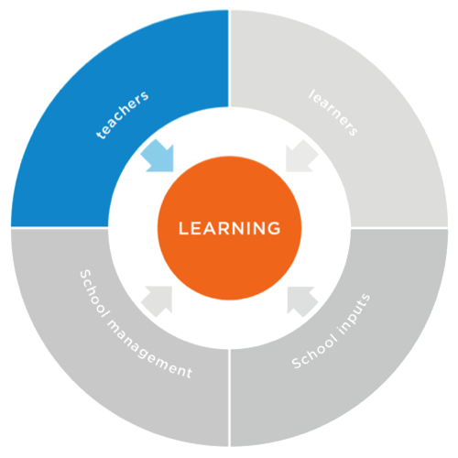
Policies
Practices
Attraction
Skills
Skills
Classroom Absence Rate
41%
Selection & Deployment
Content Knowledge
% of teachers who master content
Support
Pedagogical Skills
% of teachers at a certain level
Evaluation
Monitoring & Accountability
Policies
Teacher Presence
% of teachers present in the classroom during unannounced visit
Intrinsic Motivation
Practices
Notes:
As mentioned earlier, something that the dashboard tries to do is to go beyond the practices at the school level, to also look at the policies that could be responsible for them. For instance, if we look at the teaching indicators…

Slide 35

Policies
Practices
Attraction
3.5
Skills
Skills
Classroom Absence Rate
41%
Selection & Deployment
3.5
Content Knowledge
34%
Support
2.6
Pedagogical Skills
68%
Evaluation
3.6
Monitoring & Accountability
3.1
Policies
Teacher Presence
93%
Intrinsic Motivation
3.4
Practices
Induction – 44%
Teacher Practicum – 18%
In-Service Training – 26%
Opportunities to come together – 75%
Support
Notes:
We saw that in Jordan, content knowledge of teachers as well as pedagogical skills show room for improvement. When looking at the policies, the support teachers receive stands out as needing to improve. Particularly, we see that even though there is a policy mandating that teachers should receive in-service training, only 24% of teachers report having attended a training in the past 12 months. Therefore highlighting a potential area for action to improve teaching skills, and thus improve learning.

Slide 36
Policies
Nutrition Programs
Practices
Health Programs
Readiness for Learning
% of 1st Graders Getting 80% Correct
Early Childhood Education
Student attendance
% of Students Present in the Classroom
Policies
Caregiver Skills Capacity
Practices
Caregiver Financial Capacity
Notes:
The same is done for the other indicators of the dashboard, for instance, if we look at readiness for learning…

Slide 37
ECE
Coverage of ECE – 77%
ECE Classrooms with effective activities – 4%
Policies
Nutrition Programs
4.0
Practices
Health Programs
3.9
Readiness for Learning
52.7%
Early Childhood Education
1.6
Student attendance
93.0%
Policies
Caregiver Skills Capacity
2.3
Practices
Caregiver Financial Capacity
4.4
Notes:
We notice that this is a problem for Peru. And when we look at the policy indicators that could be somewhat driving this low level of readiness, one that stands out is the early childhood education indicator. We see that even though the coverage of ECE is good, with nearly 80% of children attending ECE, the quality of such ECE needs to be improved, given that very few classrooms seem to have effective activities. Therefore, highlighting a potential area for action. I should mention that for these indicators, since they involve things that happen outside the school, we rely on existing data to report on them.

Slide 38
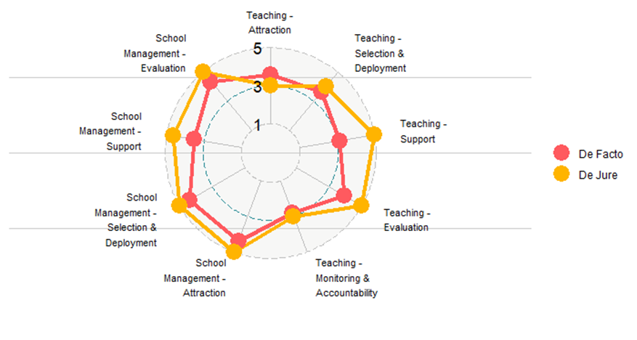
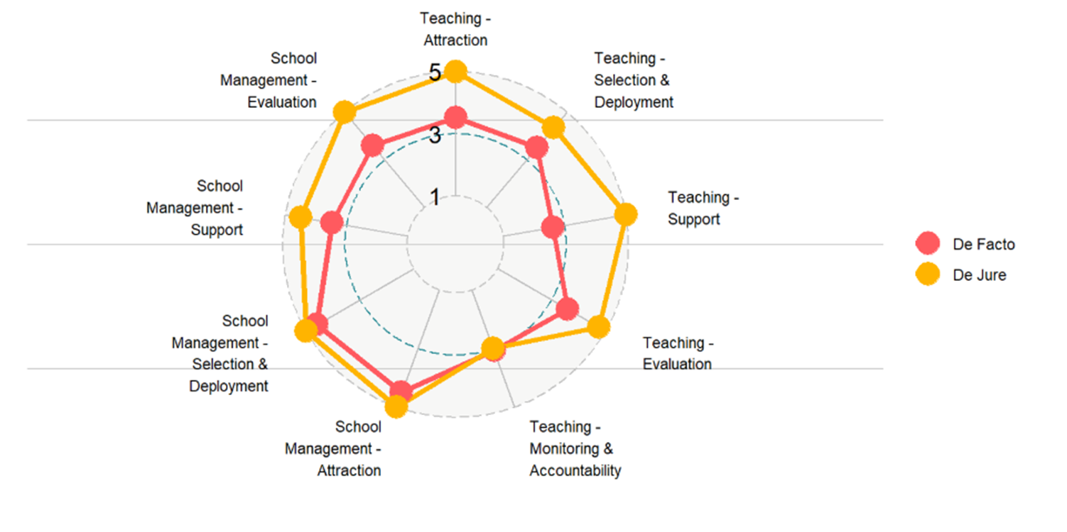
De jure and de facto measures allow for measuring implementation gaps
Peru – Gap in Policy Implementation
Jordan – Gap in Policy Implementation
Notes:
As we look at policies, it becomes critically important to look at the gap between de jure policies and de facto implementation, because they could tell you very different stories. And this is in fact something we see in the countries where we implement the dashboard. As you can see here, de jure policies, in orange tend to score quite high across all domains, meaning that on paper, they are quite comprehensive. But when we look at the de facto implementation, the red line, the scores are much lower. Meaning there are very comprehensive policy frameworks, that don’t necessarily get implemented consistently.
This is the type of finding that highlight the need to…

Slide 39
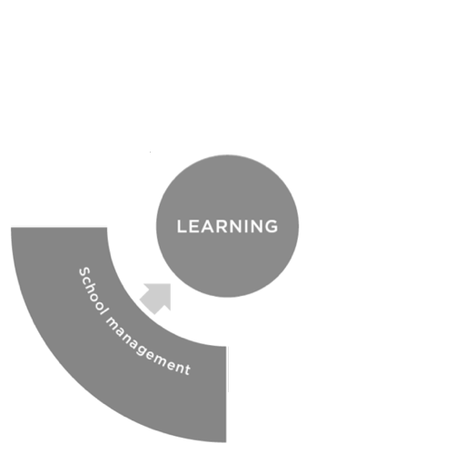
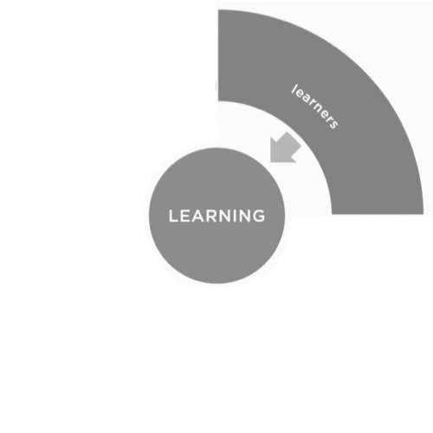
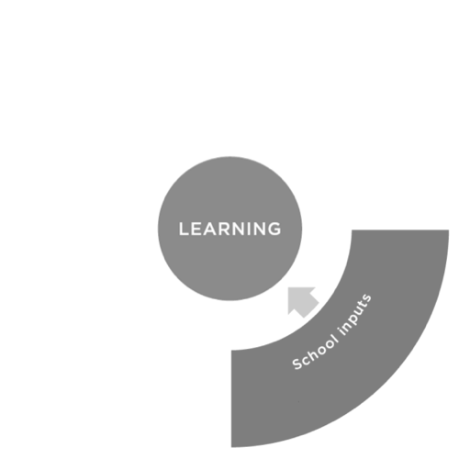
Understanding the Political and Bureaucratic Capacity of the system
Financing
4.7
Impartial Decision-Making
3.1
Mandates & Accountability
4.2
Characteristics of Bureaucracy
3.6
National Learning Goals
3.6
Politics
Policies
Practices
National Learning Goals
Targeting – 4.0
Monitoring – 3.9
Incentives – 2.9
Community engagement – 3.5
Notes:
Understand the political and bureaucratic capacity of the system. And this is something we are able to do thanks to the survey of public officials. Here, looking at the Jordan data, we see that no indicator stands out as needing significant improvement, but some do highlight areas for caution. For instance, when we look at whether or not there are national learning targets, we see that there are targets and they are being monitored, but perhaps the incentives could be strengthened and the community could play a bigger role in defining and monitoring those targets.

Slide 40
Financing
Characteristics of Bureaucracy
Impartial Decision-Making
Mandates & Accountability
National Learning Goals
Inputs & Infrastructure
Learners
Nutrition Programs
Standards
Basic Inputs
Readiness for Learning
Health Programs
Early Childhood Education
Monitoring
Basic Infrastructure
Learning
Student Attendance
Caregiver Skills Capacity
Caregiver Financial Capacity
School Management
Teaching
Core School Functions
Teachers’ Skills
Attraction
Clarity of Functions
Operational Management
Content Knowledge
Selection & Deployment
Instructional Leadership
Pedagogical Skills
Support
Attraction
Selection & Deployment
Managerial Skills
Evaluation
School Knowledge
Monitoring & Accountability
Support
Management Practices
Teacher Presence
Evaluation
Intrinsic Motivation
Notes:
Ultimately, the goal is to provide countries with a full snapshot of their system so that they can identify areas for action and then monitor progress as they continue to act. Here we can see the data for Peru, at all levels – Outcomes, Practices, Policies, and Politics.

Slide 41
Financing
Characteristics of Bureaucracy
Impartial Decision-Making
Mandates & Accountability
National Learning Goals
Inputs & Infrastructure
Learners
Nutrition Programs
Standards
Basic Inputs
Readiness for Learning
Health Programs
Student Attendance
Early Childhood Education*
Monitoring
Basic Infrastructure
Learning
Caregiver Skills Capacity
Caregiver Financial Capacity
School Management
Teaching
Core School Functions
Teachers’ Skills
Attraction
Operational Management
Content Knowledge
Selection & Deployment
Clarity of Functions
Instructional Leadership
Pedagogical Skills
Support
Attraction
Selection & Deployment
Managerial Skills
Evaluation
School Knowledge
Monitoring & Accountability
Support
Management Practices
Teacher Presence
Evaluation
Intrinsic Motivation
Notes:
But the goal is to ensure every country has access to a similar snapshot of their indicators.

Slide 42
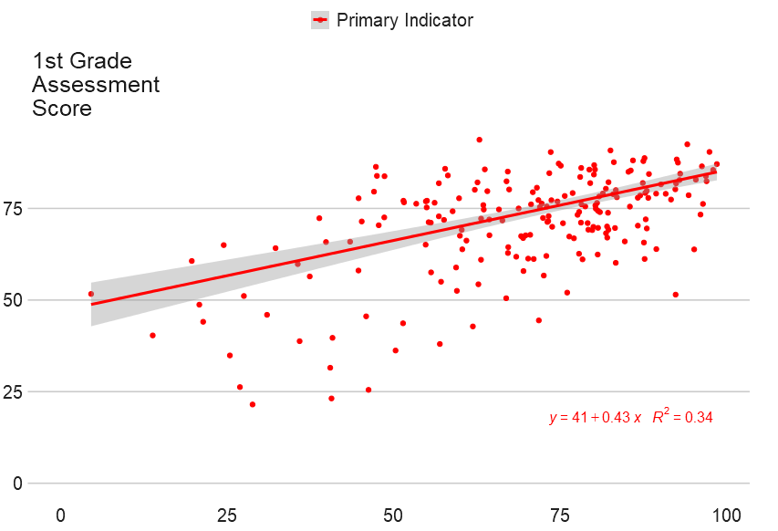
Allowing for a deeper understanding of the relationships between school-level factors and learning
Example 1
Aggregate of the school management indicators is strongly related with…
Example 2
Aggregate of the school management indicators is strongly related with…
Better learning outcomes
Better infrastructure
Aggregate School Management Quality Index, by Quartile
Lowest
Third
Second
Highest
Notes:
And the value of having all data collected and reported in one place is that it becomes easier to look at the relationship between different factors. Here, in example one, we can see a strong relationship between the quality of school management and learning outcomes and other school factors like basic infrastructure. In example 2, we can see the strong relationship between the readiness for learning indicator and the 4th grade learning outcomes. And making sense of these relationships can offer a strong evidence base for countries to define their strategies to improve learning.

Slide 43
How countries can benefit
Countries with low or no data infrastructure
Countries with some data infrastructure
Countries with advanced data infrastructure
Complement efforts to build or improve EMIS or other data systems
Fill the gap in the short term by offering data to identify learning bottlenecks cheaply and quickly
Build capacity and data infrastructure
Complement EMIS, as data collected falls outside the scope of a standard EMIS
Build capacity by identifying data gaps in existing data systems and sharing a suite of resources that can be incorporated into a country’s regular monitoring
Offer data on policy and politics and bureaucratic capacity, which are generally not collected
Serve as an audit of existing data
Provide access to instruments, training materials, and processes that can improve the quality of existing data monitoring systems
Notes:
we do see benefits to different types of countries. On the slide you can find some specifics, but across countries, the dashboard offers data that is generally not collected, so it can help inform policy. And at the same time, obviously in different degrees depending on the country, but it can also help build capacity within the country as the country can leverage the instruments, framework, training materials, and everything to strengthen their own data systems

Slide 44
GEPD Resources Available
Notes:
Now, very briefly, today’s event is called the rollout, because we are essentially rolling out the dashboard and making a number of resources available.

Slide 45
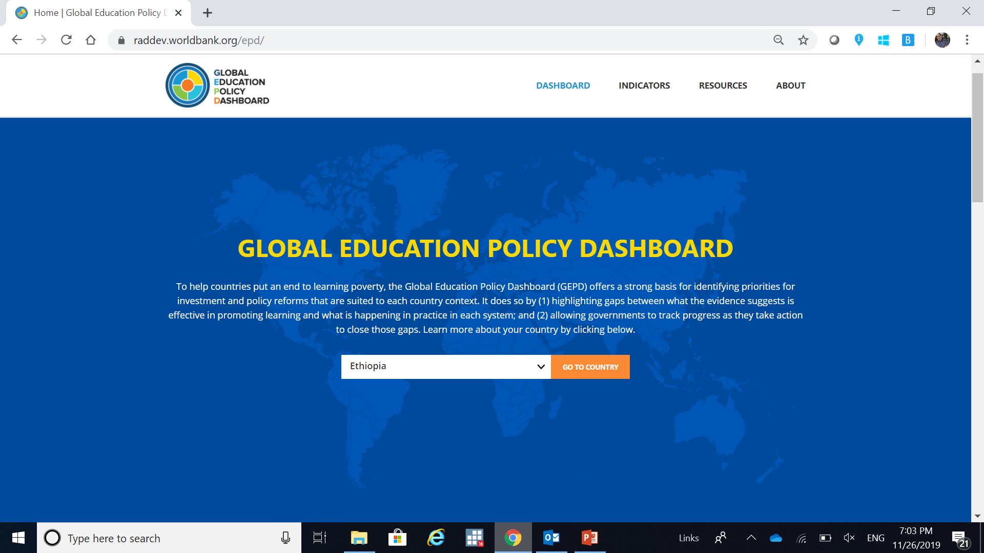
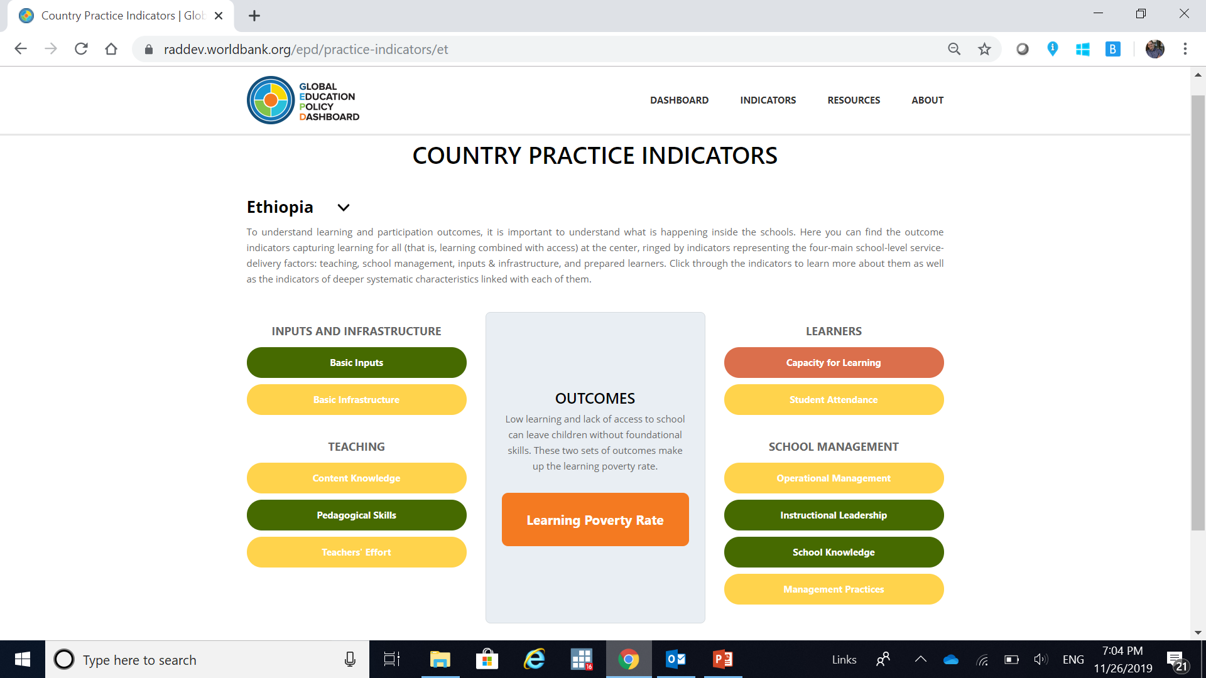
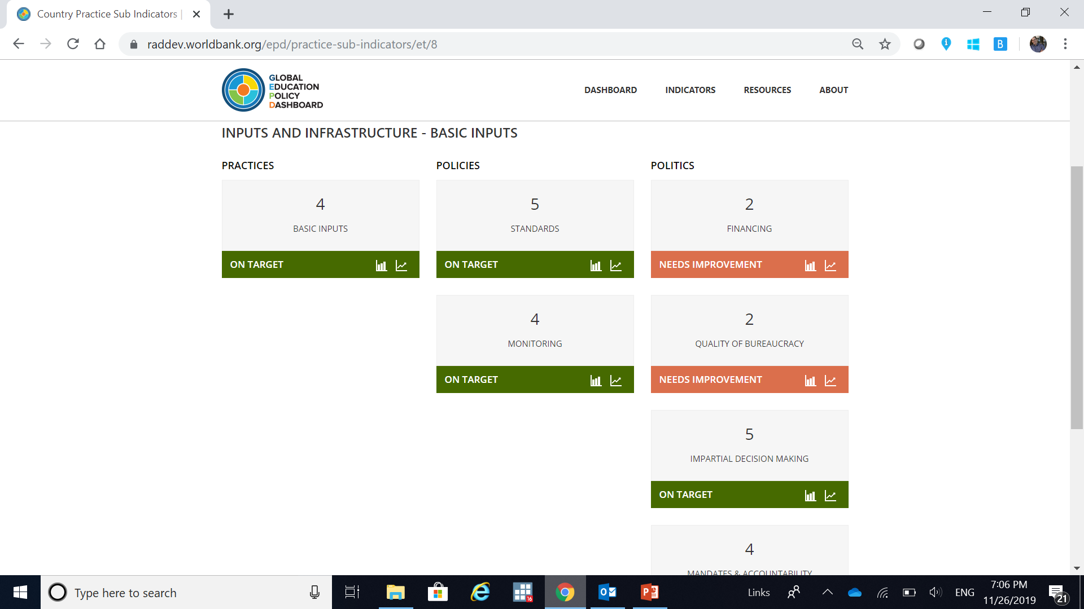
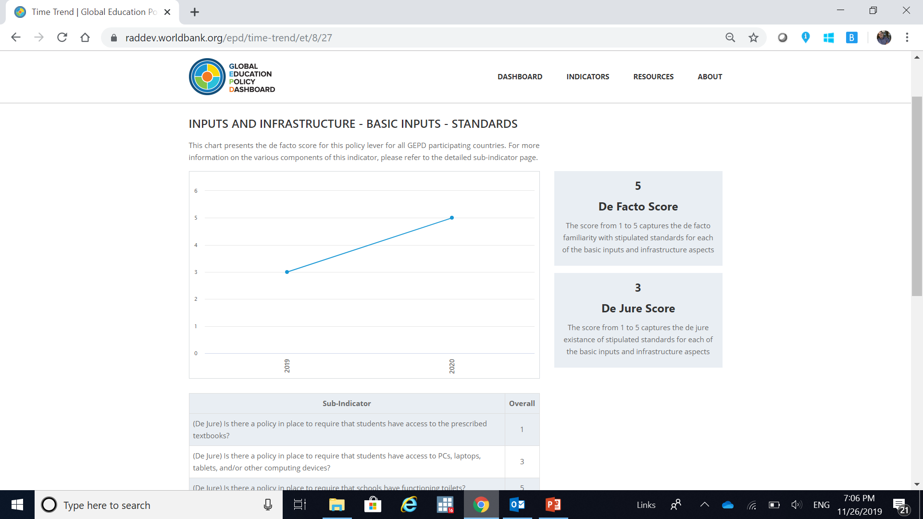
A user-friendly website to host data and resources www.EducationPolicyDashboard.org
1
2
3
4
Notes:
The first one, a user-friendly website that contains all the data collected. This will be updated regularly as more data becomes available. In this website, you will also find a number of resources…

Slide 46
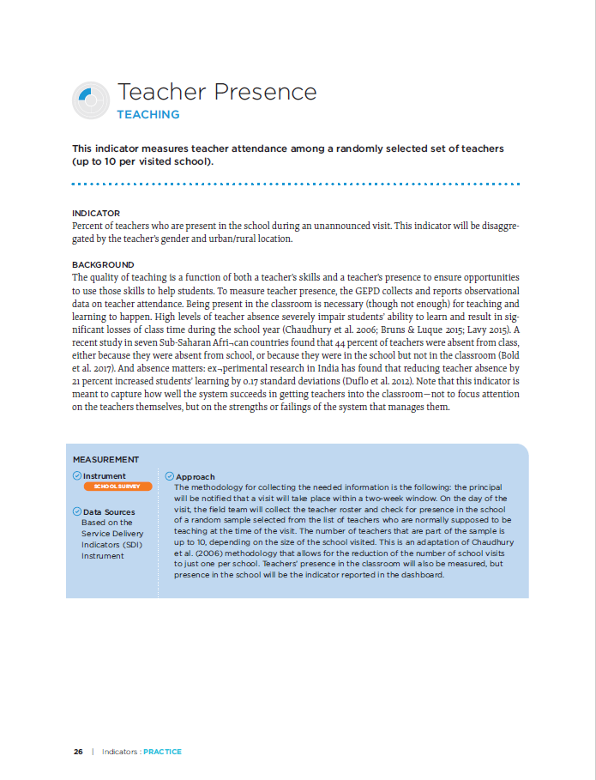
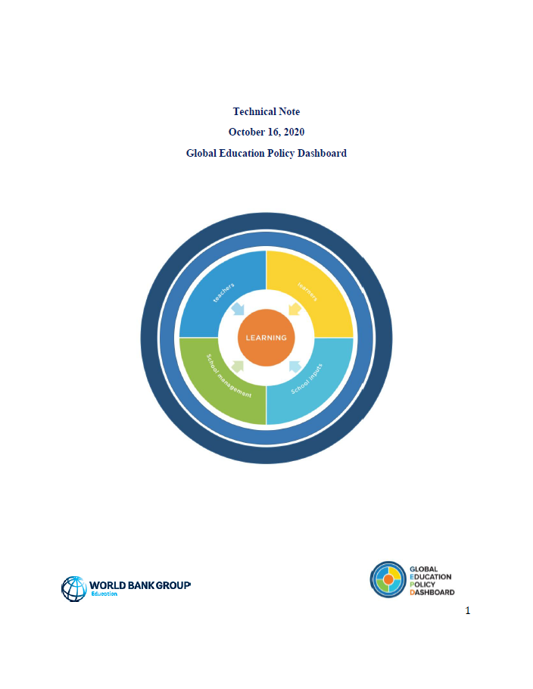
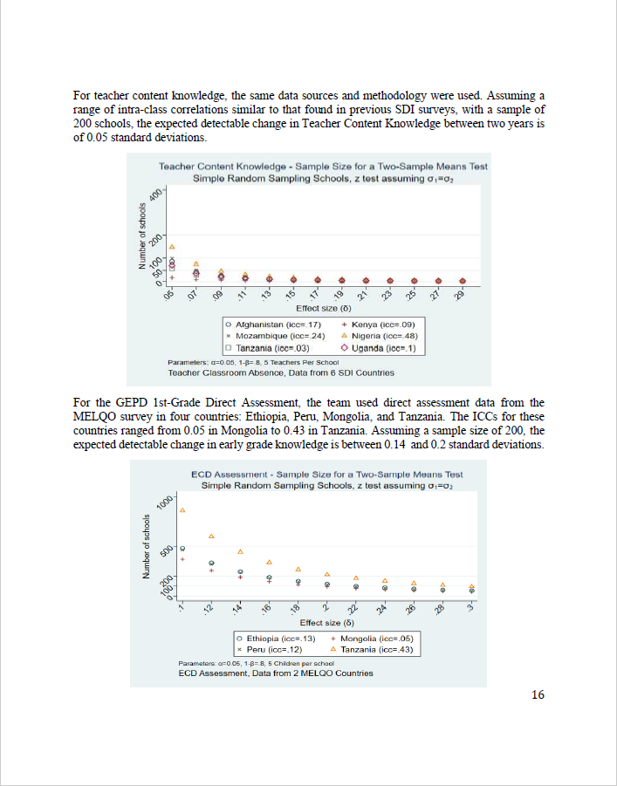

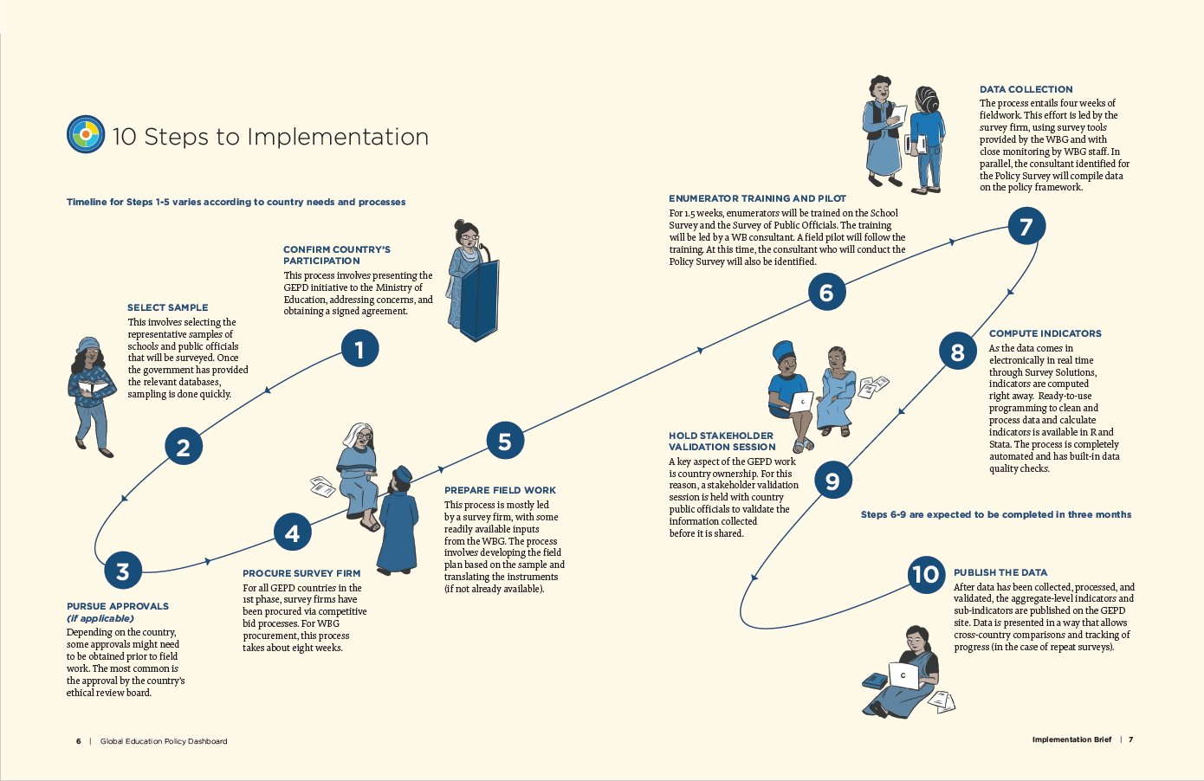
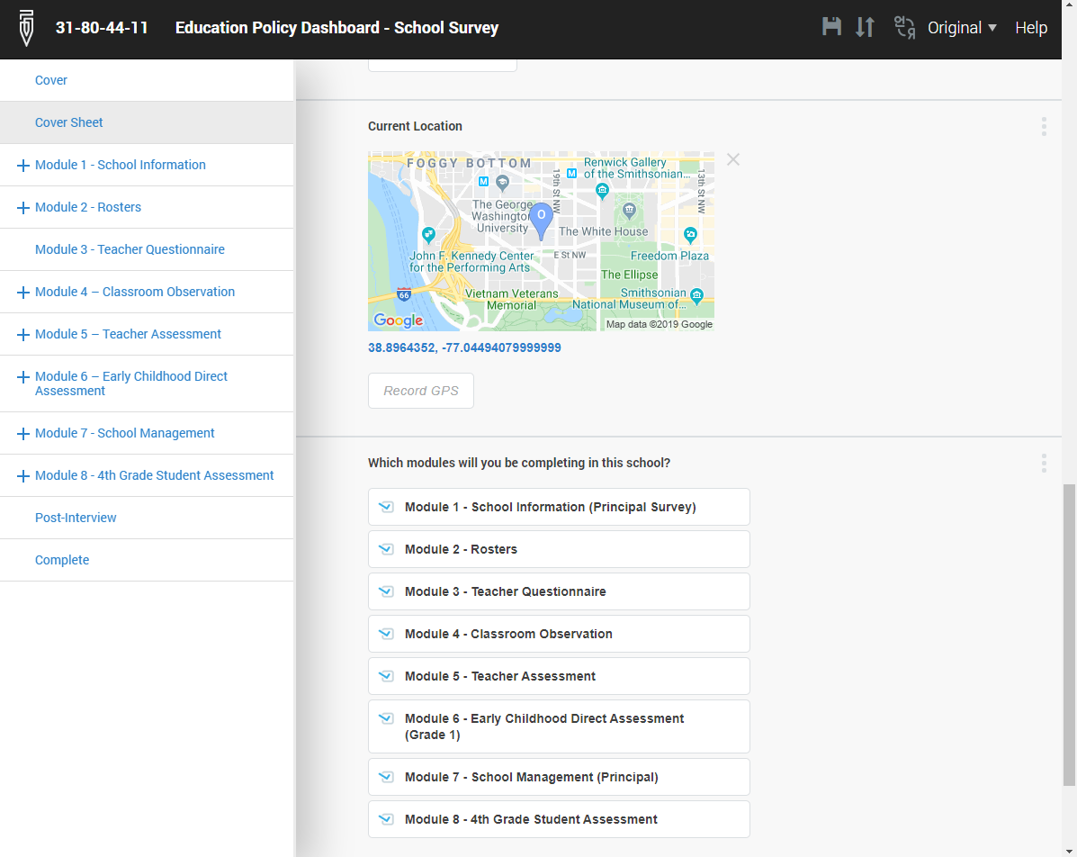
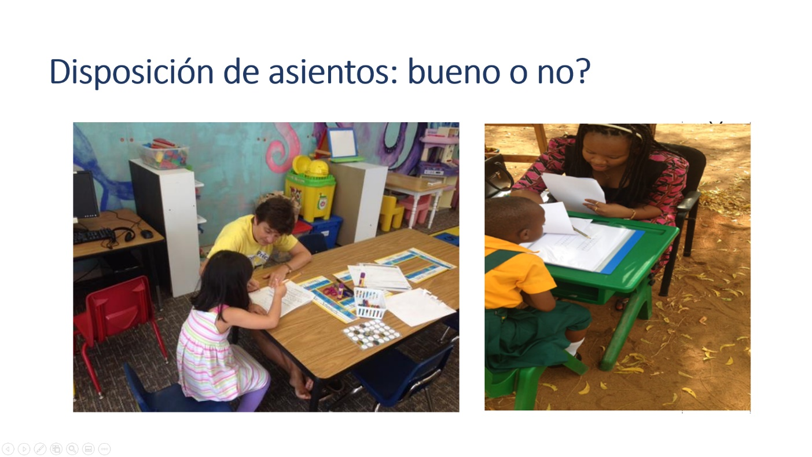
A suite of technical resources to understand and use the GEPD
GEPD Reference Guide
GEPD Implementation Brief
GEPD Technical Note
GEPD Instruments
GEPD Training Materials
Notes:
Particularly, the Dashboard Reference Guide which is the most comprehensive document outlining the basics of the initiative,
the Dashboard implementation brief, which describes the implementation process for countries or partners thinking of implementing the dashboard,
and other resources

Slide 47
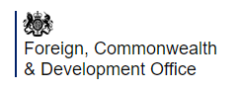
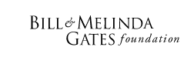







Result of a collaboration across many teams
Strategic Partners – Outside the WB
A High-Level Technical Advisory Board
Strategic Partners – Within the WB
Notes:
Needless to say, this has been an enormous amount of work that was made possible thanks to all the people that contributed to it.
First and foremost, Reema Nayar, she is not just our moderator, she is the person who led this team for the past two years and made the project what it is today. We also count with strategic partners, like FCDO and Gates Foundation that have supported us with funding and technical guidance. Even within the bank, this has involved the collaboration across many teams within the education global practice, but also from other global practices that have helped develop our surveys and indicators. And last but not least, our technical advisory board, which has guided us through the life of the project.
At the end of the day, if this project brought together so many partners and colleagues

Slide 48
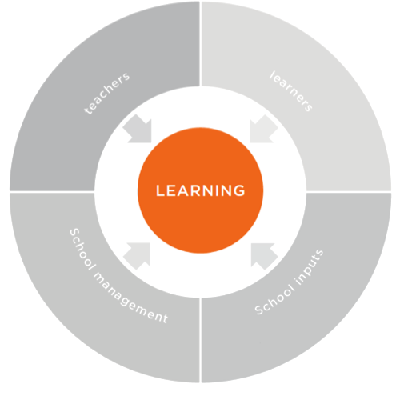
Politics
Practices
Policies
Notes:
Is because we all see the power of education and learning. And as great as it is that we are now measuring learning more and highlighting that there is a learning crisis to motivate action.
To improve learning…

Slide 49
Politics
Policies
Practices
Notes:
We have to understand its drivers. To understand where the problems are and whether we are moving in the right direction. And this desire to have a better understanding is found everywhere. The most frequently asked question I have to answer when implementing the dashboard, from students, teachers, principals, public officials, partners is always– when will I get to see the data? When will I get to see my results? No matter the level, no matter the country, there is a demand for this data, and we hope the dashboard can meet this demand.

Slide 50


Thank you!
Notes:
With that said, thank you all for joining us today. And let me turn it over to Reema so she can lead us into the next discussion.

